Slide 1
Organisational Behaviour
Module 1
The Basics of Organisational Behaviour and its Relation to Management

Slide 2
Definition of Organizational Behavior
Organizational behavior is the study of the behavior and attitudes of people in organizations.
It focus on human behavior and attitudes which contribute to the effectiveness and productivity of any organization .

Slide 3
Organizational Behavior
Units of Analysis
O.B.
Individual
Group
Organization

Slide 4
The Relationship of Management to Organizational Behavior
Organizational behavior is a social science that develops knowledge about the behavior of people at work.
Organizational behavior is an applied discipline which explain behavior in organizations in terms of valid theories.
It concentrates on the acquisition of knowledge about organizational productivity and employee needs.

Slide 5
Management
Management is defined as the process of planning, organizing, leading, and controlling the human, material and financial resources of an organization.
Management is a professional discipline which stresses applied skills .
Management deals with accomplishment of organizational goals and involves the technical and human components of organizational functioning.

Slide 6

The Manager’s Job
The key concept in the manager’s job is
‘getting things done through people’.

Slide 7
The Managerial Skills
In the middle management level, conceptual workload and human workload increase while technical workloads diminish.
Top managers spend the bulk of their time engaged in conceptual and human work.
The missing skill in the skill mix for many managers is the human component of managerial work. ‘Poor people skills’.

Slide 8
Competitive Advantages
Competitive advantages of organizations depend on the quality and motivation of the workforces.
Strengthening of organizational competitive advantage could be achieved by strengthening the manager’s grasp of human forces issues.

Slide 9
The Manager’s Job,
New Perspectives
The rate of change in the manager’s job is being increased by:
  Workforce diversity
  Demands for better products and services
  New concepts like employee empowerment
The manager’s job in the twenty first century will focus on coaching, integration and conflict resolution skills rather than giving orders, determining promotions and making autocratic decisions.

Slide 10
The Manager’s Job,
New Perspectives
The future workplace requires greater speed, efficiency, responsiveness and flexibility.
Organizational control structures emphasizing command and control are turning into participative decision systems & empowerment.
The modern manager’s job will evolve from an authority derived to facilitates teamwork and empowerment.

Slide 11
Managers’ challenges in 21st century
 | Past challenges | Future challenges
Training and development | Reduce these costs by hiring workers with requisite skills | Training and employee development are continuous to achieve the goals
Reward bases | Seniority, rank and effort | Merit-based individual and team
Influence base | Hierarchical position | Technical and interpersonal expertise
Communication patterns and styles | From top to the bottom | Information goes rapidly to where the decision has to be made
Decision-taking style | Boss centred and authoritarian | Team-based and participative
Approach to organisational change | Resist change | Embrace change
1. The workforce is changing.
2. Customer expectations are changing.
3. Organisations are changing.
Notes:
1. The workforce is changing.
2. Customer expectations are changing.
3. Organisations are changing.

Slide 12
The SOBC Sequence
Kurt Luwin
S: Stimulus or Situation = All sensations from the environment which trigger human perception. It includes all features of the work environment which activate employee behavior.
O: Organism = The capacities of the individual which are governed by heredity, maturity and biological needs. It includes knowledge, skills, attitudes, intentions, sentiments and values.
B: Behaviours and actions such as performance or emotional responses
C: Consequences or Outcomes = the outcomes of behavior and performance such as recognition and need satisfaction.

Slide 13
Values: The Building Blocks of Individual Differences
Definition of Values:
Values are enduring beliefs that a specific mode of conduct or end is personally or socially preferable to an opposite.
  New situations shape and form values through adolescence and stabilize to a system.
  Values are used to judge our own behavior and the behavior of others.
  Values are not changed easily.

Slide 14
Values, Cont.,
Values develop into a coherent sense of self known as our self-concept.
Self-concept is used to judge the appropriateness of our behavior and the behavior of others & to judge the meaningfulness of our goals in life
Values give us a sense of right or wrong.
Values form the basis for business behavior.

Slide 15
Values, Cont.,
Current issues:
  The growth of emphasis on ethics in business practices.
  Companies, Values and business practices.
Terminal and instrumental values
  Values can be instrumental or terminal:
    Instrumental values are the means to achieve goals by using acceptable behaviors .
    Terminal values are the goals to be achieved.

Slide 16
Values, Cont.,
Examples of Terminal values
  Achievement
  Freedom
  Social status
  Pleasure
Examples Instrumental values
  Competence
  Self-control
  Cleanliness
  Courage
  Politeness

Slide 17
Implications of Values in Global Organizations
Expansion of global activities and the challenge of culture based value differences.
  The instrumental value of loyalty is more important to Japanese workers than family loyalty.
  In the USA, family loyalty far outweigh loyalty to employers.
Values shape the individual’s views of authority and its rights and obligations.
  French manager view authority as a rank & use power based on position.
  Scandinavian value group discussion and decisions are challenged.

Slide 18
Implications of Values in Global Organizations, Cont.
Overseas assignments for field & life training in culture based value differences.
Organizations are providing culture based values training to smooth the transitions for their managers who receive global assignments.

Slide 19
Employee Needs and Organizational Productivity
Employee needs are job satisfaction, adequate pay and fringe benefits and safe working conditions.
Organizational productivity refers to the production or output of goods and services with the least resources.
Organizational behavior focuses on the connection between employee behavior, attitudes and the productivity of the organization.

Slide 20
Personality and Personal Traits
Personality is defined as a relatively permanent set of psychological characteristics, that influence the individual’s behavior.
Individual differences are defined as basic aspects of personality from which we can predict or explain what people do at work.

Slide 21
Locus of Control
Locus of control refers to one’s beliefs about what cause outcomes in life.
or
the strength of one’s belief that personal action will result in certain outcomes.
Internals see themselves as the cause of outcomes, while externals believe outcomes are created by forces and events outside themselves.

Slide 22
Locus of Control
Locus of control refers to one’s beliefs about what cause outcomes in life.
Internals believe in the causality of personal behaviour, while externals believe in the causality of environmental forces.
Internals see themselves as the cause of outcomes, while externals believe outcomes are created by forces and events outside themselves.

Slide 23
Examples of Internals Beliefs
Internals tend to believe that
  Pay rises are based on hard work, achievement and initiative.
  An excellent performance record is the function of hard work and effective project completion.
  Good decisions are the result of hard searching for information.

Slide 24
Examples of Externals Beliefs
Externals tend to believe that
  Pay rises are based on having the right job in the right place in the company.
  Teachers have favorites and give them higher marks.
  People’s attitudes cannot be changed easily by appealing to their logic.

Slide 25
Locus of Control & Work Behavior
Internals are:
  Attracted to opportunities with development.
  More Motivated.
  Better Performers.
  Search for relevant information before deciding.
  Sensitive to influence their behaviour.
  Express entrepreneurial behavior and risks taking.
  Prefer to play a part in decisions affecting them.

Slide 26
Managerial Implications
Internalizes will work harder when rewards are based on superior skill and high performance.
The value of skill based compensation is very important for developing employees with an internal locus .
A firm’s pay system should be designed to reinforce skill based compensation (pay for knowledge) & acquisition of new job related skills.
Managers have to use participation in decision making.

Slide 27
Extroversion and Introversion
Extroversion and introversion refer to the strength of one’s need for external sensory stimulation.
Extroversion is defined as
  The need to obtain social stimulation from the environment
Introversion is defined as :
  Avoidance of external stimulation in favor of internally oriented activity.

Slide 28
Extroversion and Introversion
  Individuals who are outgoing are called extroverts
  Introverts prefer less external ‘social noise’ than extroverts and usually are:
    Shy and less willing to get involved in social activities.
    More sensitive to their personal feelings .
  People experience both types of needs at different times, with varying intensity depending on the situations .

Slide 29
Organizations & Information Use of Introversion and Extroversion
Some companies attempt to identify a job applicant’s extroversion level before hiring. e.g. Salespeople .
The implication of an employee’s extroversion or introversion are not clear as are the consequences of locus of control.
Managers should consider these effects as they match individuals with job characteristics.

Slide 30
Organizations & Information Use of Introversion and Extroversion
Introverts have fewer unexcused absences .
Too much external stimulation often causes the introvert’s performance to drop off quickly.
Extroverts are more likely to engage in irrelevant behaviour which undermines the productivity of coworkers .

Slide 31
The Machiavellian Personality
Machiavellism is the need to influence others to achieve one’s personal ends.
‘The end justifies the means’.
Employees with this tendency manipulate others .
High Machs are highly rational.
The MachV Scale is a test which identifies Machiavellian tendencies.

Slide 32
High Machs & the Influence on the Organization
Ambiguous situation & high Mach tendencies increase.
Machiavellian manipulations increase at the top of organizations.

Slide 33
Socially Acquired Needs
Environment plays a key role in the development of personality.
Socially acquired needs are the needs learned through personal contact with the social environment.

Slide 34
Socially Acquired Needs
The three most important needs from the organizational perspective are :
  The need for achievement.
  The need for affiliation .
  The need for power.
The socially acquired needs are very important factors in understanding employee behavior.

Slide 35
The Need for Achievement
The need for achievement is defined by:
  1- Taking moderate risks by pursuing challenging goals.
  2- Needing feedback on performance and progress.
  3 - Task activities and accomplishments are rewarding, regardless of the financial issue.
  4 -Defining work in terms of approaching success .

Slide 36
The Organizational Importance of Need for Achievement
High achievement need equals higher performance.
High need for achievement matters most when work settings emphasize :
  1) The employee’s ability.
  2) High quality performance feedback .
  3) Stimulating and novel work activities.
Need for achievement is related to the desire to become an entrepreneur.

Slide 37
Managers & the Use of Information about Need for Achievement
Successful managers should:
  1- Use the need for achievement as one of the bases for screening job applicants.
  2- Use it as a factor in promotion decisions.
  3- Design jobs with challenging goals .
  4- Design rewards that are tied to performance .
  5- Reward employee creativity.

Slide 38
Need for Affiliation
The desire to have & maintain a strong social support system, and to give and receive affection.
Need for affiliation is defined by the following qualities:
  Reacting positively to experiences which enhance belonging.
  Emphasizing group members to be included .
  Solving interpersonal conflicts.
  Emphasizing the importance of social rewards such as recognition and praise.

Slide 39
How Can Managers Capitalize on Need for Affiliation in Employees?
1- Be arbitrators of workgroup disputes.
2- Evaluate the social demands of a job and match employees with a high need for affiliation.
3- Develop and use social rewards dependent on high performance .
4 - High need for affiliation may incorrectly emphasize social harmony over productivity.

Slide 40
Need for Power
It defines behaviors oriented towards influencing others and searching for opportunities to gain influence and control.
Need for power has two forms of expression: personalized and socialized power.
The need for power has two sides:
  Negative Side: The personalized need for power ( trying to dominate others).
  Positive Side: The socialized need for power.

Slide 41
The Personalized Need for Power
Firms frequently view people with personalized need for power as unproductive:
  1- Reject responsibilities in favor of personal concerns.
  2 -Create tense work relations among subordinates .
  3 -Poorly adjusted to work.
  4 -Project their own inadequacies on workers and subordinates.

Slide 42
The Socialized Need for Power
The manager tends to achieve his personal goals at work through raising the self-esteem of his staff.
He/She gains higher levels of performance from subordinates by demonstrating his confidence in them.
He/She implies that the best kind of organizational control is self-control in each employee.
The socialized need for power is an important managerial quality & associates with effectiveness.

Slide 43
The Socialized Need for Power
The socialized need for power is the most important need for managerial success.
The manager with a high need for achievement often errs and completes a task himself rather than delegating it to a subordinate.
The task focus of the manager with a strong achievement orientation prevents him from being a good manager of people.

Slide 44
Techniques for Managing Employees with Power Needs
1- Employees who exhibit a socialized need for power should be selected and promoted.
2- Positions requiring socialized power should be given a high profile.
3- Managers with socialized power should take charge of groups of low performance or morale.
4- Career paths for managers with socialized power needs should be open.

Slide 45
Job Satisfaction
Job satisfaction is a key work attitude.
It is a function of employee perceptions of the facets of the work setting, rewards, supervision, and job demands.
Each facet is an attitude.
An attitude is a predisposition acquired through experience, to respond to people, objects or organization in a positive or negative way.

Slide 46
Job Satisfaction ,Cont.,
The facets of job satisfaction are attitudes which focus on:
  1) Satisfaction with the work itself.
  2) Satisfaction with pay.
  3) Satisfaction with fellow workers.
  4) Satisfaction with supervision.
  5) Satisfaction with promotions.

Slide 47
Determinants and Consequences of Individual Job Satisfaction
Individual differences influence experienced levels of satisfaction for employees.
Two of the prominent determinants of job satisfaction are years in career and job expectations.
Years in Career
As employees grow older, they experience more satisfaction at work until approaching retirement.
A sharp decline in job satisfaction often occurs for employees who spent six months to two years.

Slide 48
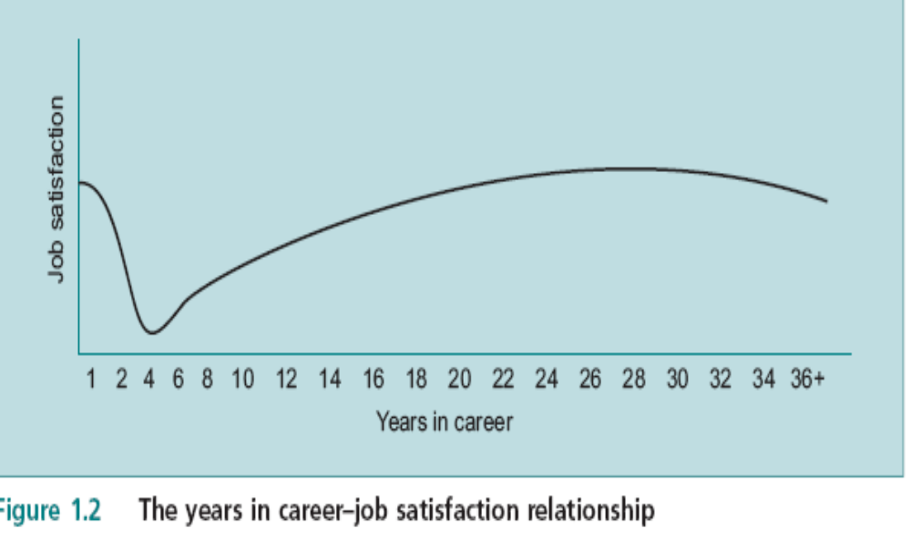
The Impact of Years in Career on
Job Satisfaction

Slide 49
Individual Job Satisfaction
Expectations
  Expectations about work are influenced by information from colleagues and knowledge acquired about market conditions.
The fall in job satisfaction is a management concern & can be costly in terms of hiring and training.
The level of experienced job satisfaction is determined by job challenge, job clarity, supervision and incentives.

Slide 50
The Organizational Determinants of Job Satisfaction
Supervision
Considerate supervision supports employees’ self esteem and self worth.
Participative supervision has the effect of clarifying employees’ expectations .
Employees with clear work expectations are more self-confident.

Slide 51
The Organizational Determinants of Job Satisfaction ,Cont.,
Job Challenge
Creativity, application of personal skills and risk taking.
Employees with a high need for achievement are more satisfied with intellectual effort.
Job Clarity
The extent to which employees understand what they are to do.

Slide 52
The Organizational Determinants of Job Satisfaction ,Cont.,
Incentives
Incentives are very powerful tools for maintaining motivation and performance.
Extrinsic rewards are based on employee performance and effort.
  Examples: pay rises, promotions, recognition and status symbols.
Intrinsic rewards are those that the employee experiences internally.
  Examples: feelings of competence and pride.

Slide 53
The Equity Theory
Employees make comparisons about their rewards relative to their effort and performance levels relative to other employees.
These comparisons are referred to as ‘social comparisons’ which result in perceived equity .
The comparison can be another employee, employees in a profession or employees in a similar organization.
Perceived inequity represents a state of psychological imbalance.

Slide 54
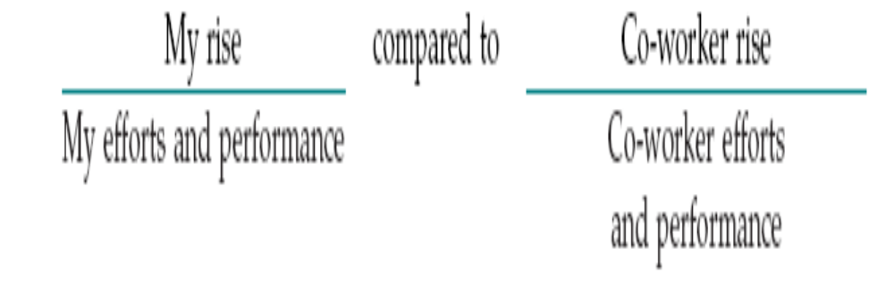
The Equity Theory

Slide 55
The Equity Comparison
Employees constantly make equity comparisons.
The ways of the individual to restore balance are to:
  1) Reduce effort and performance.
  2) Change the ‘comparison other’ to a more suitable coworker.
  3) Increase the levels of effort and performance .
  4) Eliminate the problem by leaving the job.

Slide 56
Job Satisfaction
Job satisfaction is composed of the facets of pay, promotion, coworkers, supervisors and the work itself.
The connection is determined by the availability of both intrinsic and extrinsic rewards, and by employees’ perception of the fairness of their distribution.

Slide 57
Job Satisfaction
The Consequences of high job satisfaction
  Employees report less absenteeism. (A high absenteeism drives up indirect costs)
  Improvement of resistance to job stress and its physical symptoms.
  Lower turnover, i.e. lower recruiting, hiring and training costs (all indirect costs).

Slide 58
Job Satisfaction & Performance
Satisfactory performance triggers the release of various intrinsic and extrinsic rewards.
Extrinsic rewards are available through the compensation system.
Intrinsic rewards are linked to the way the task is designed
  e.g. level of challenge, clarity, variety of skills used and opportunity to learn new skills.
The compensation system and the job design must function properly to ensure perceived equity.

Slide 59
Job Satisfaction
Individual differences influence job satisfaction.
Employee characteristics also interact with the work situation to influence job satisfaction levels.
Employees with a strong internal locus of control would experience job dissatisfaction through perceived inequity, in case of little challenge & an ineffective compensation system.

Slide 60
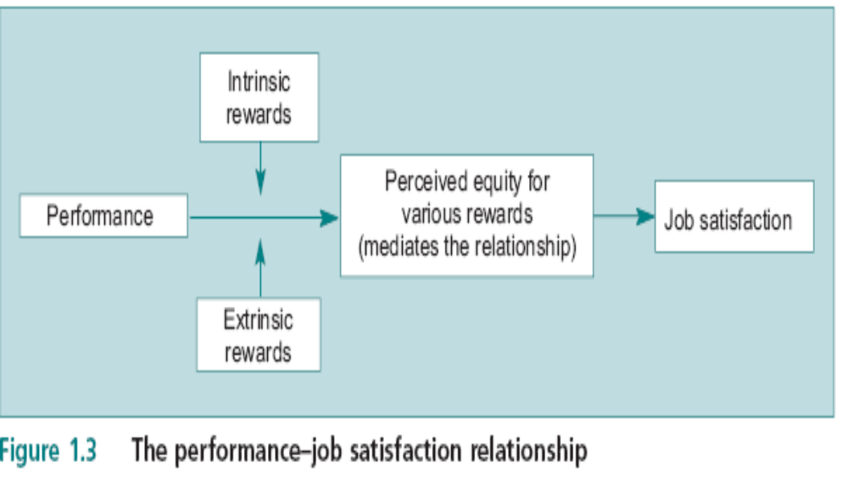
The Performance–Job
Satisfaction Relationship

Slide 61
The Performance–Job
Satisfaction Relationship
The model indicates that a direct relationship between performance and job satisfaction does not exist.
Perceptions of equity tie the two together.
Employee characteristics also interact with the work situation to influence job satisfaction levels.

Slide 62
Job Satisfaction Measures
Observing Behaviour
Interviews
Questionnaires
Job Description Index, JDI
Minnesota Satisfaction Questionnaire
Problems of using questionnaires.

Slide 63
Organizational Commitment
Organisational commitment is defined as the strength of an employee’s identification with the organisation.
Organizational commitment
  Employee agreement with goals.
  Willingness to exert effort .
  A desire to maintain membership.
It takes long time to form but once formed, is more resistant to change.

Slide 64
Organisational Commitment
Waves of downsizings and mergers cause employees to doubt the value of their expressions of organisational commitment.
Committed employees are much less likely to leave their jobs.
Organisational commitment correlates inversely with employee turnover.

Slide 65
Organizational Commitment
The committed employee would defend the organisation’s reputation in the face of criticism.
Organisational commitment develops slowly and consistently over time.
Goes beyond company loyalty.
Commitment to an organisation requires a wider perspective (towards the entire organisation), while job satisfaction results from employees’ reactions to their jobs.

Slide 66
Organisational Commitment
Employees with organisational commitment may perform better &set more ambitious goals.
Committed employees expend more job effort and they can be more productive .
These outcomes are at risk in organisations that attempt to improve their competitiveness by downsizing rather than by improving the flexibility and skills of their workforces.

Slide 67
Job Involvement
Job involvement is an important work attitude.
It is defined as the degree to which employees identify with their job, participate in it and consider to be a key determinant of their self worth
Job involvement activates beliefs that the job is a central component of one’s life.
Job involved employees are likely to view work as a major source of life satisfaction.

Slide 68
Job Involvement
Employees can have job involvement without being committed to the organization.
Employees who remain on the job after downsizing and corporate restructure have less direct, negative effects on their levels of job involvement.

Slide 69
Raising Commitment & Involvement
Caring about employees’ welfare.
Creating Opportunities to achieve personal goals.
More involvement in decision making.
Regular rewards (intrinsic) & support.
Agreed goals.
Development of managerial competencies in subordinates.

